Slide 1

Reinforcement Learning in Generative AI: A Comprehensive Study of RLHF, Reward Modeling, and Applications in Game Design
By Eng. Omar Abdelhameed , Eng. Rawan Sharif , Eng. Reem Ali
Under the supervision of Dr.W.Shalash,
Faculty of Computers & Artificial Intelligence (BFCAI), Egypt.
11-February 2025

Slide 2
Agenda
Introduction
Timeline
Areas of growth
Summary
Primary goals
Presentation Title

Slide 3
Introduction
Generative AI and Reinforcement Learning (RL) are transformative advancements in modern Computer Science.
RL has shown success in generative AI, game design, and natural language processing (NLP).
This survey explores the intersection of RL and generative AI, focusing on applications, challenges, and future directions.
How can RL improve generative AI models, particularly in content generation and game design?
What are the challenges in integrating RL with large language models (LLMs)?
What are the future directions for RL in generative AI?

Slide 4


Key Terms & Concepts: Reinforcement Learning (RL): A machine learning paradigm where an agent learns to make decisions by interacting with an environment to maximize cumulative rewards. Large Language Models (LLMs): Models like GPT, BERT, and LaMDA that use transformer architectures for tasks like text generation, translation, and summarization. Reinforcement Learning from Human Feedback (RLHF): A method to fine-tune models using human feedback to align outputs with human values.
ANNUAL REVENUE GROWTH

Slide 5
Relevance of the Topic: RL enhances the adaptability and efficiency of LLMs in dynamic, real-world tasks. RL is crucial for optimizing decision-making in generative AI, game design, and NLP.

Slide 6
Research Methodology
Databases Searched:
Google Scholar, IEEE Xplore, ACM Digital Library
Keywords Used:
"Reinforcement Learning and Large Language Models"
"RL and LLMs integration"
"Reinforcement Learning for NLP tasks"
"RLHF and LLMs"
"Deep RL in NLP"
Inclusion/Exclusion Criteria:
Focus on studies integrating RL and LLMs within a common framework.
Exclude studies solely focused on training original LLMs with RL.

Slide 7

Key Findings & Trends
RL improves LLM performance in text generation, dialogue systems, and decision-making tasks.
RLHF has proven effective in aligning LLM outputs with human values.
RL agents can optimize decision-making in real-world applications with LLM assistance.

Slide 8
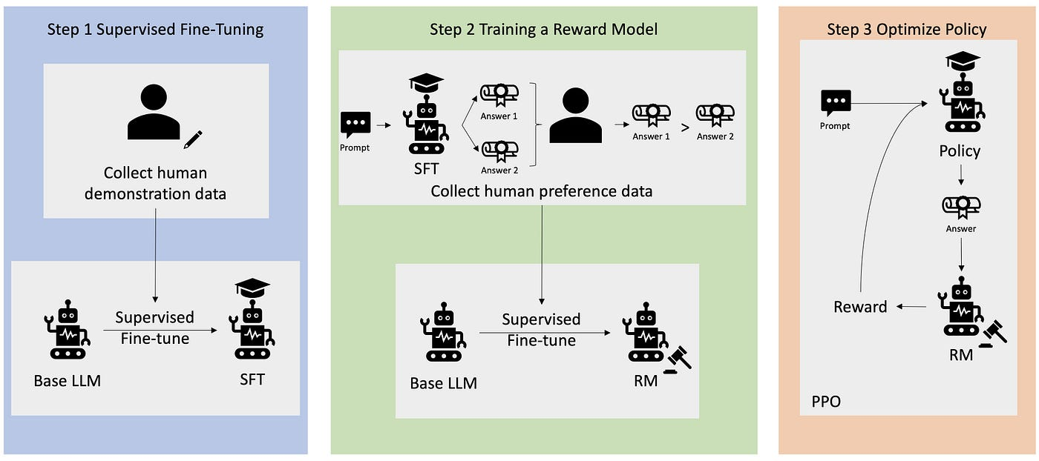

Slide 9
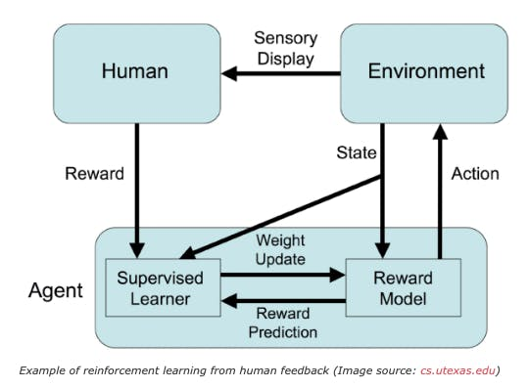

Slide 10
Challenges & Research Gaps
Major Challenges:
Sparse and potentially inaccurate reward signals in RL.
Computational complexity and resource requirements for RL-enhanced LLMs.
Difficulty in generalizing RL-enhanced models across diverse tasks.

Slide 11
Challenges & Research Gaps
Research Gaps:
Need for more stable reward functions in RL.
Exploration of multi-task learning in RL/LLM systems.
Ethical considerations, including fairness and transparency in RL/LLM systems.

Slide 12
Future Research Directions
New Research Topics:
Generalizability: Ensuring RL-enhanced LLMs perform well across various tasks without extensive re-training.
Reward Design: Developing more stable reward functions for RL agents in dynamic environments.
Multi-Task Learning: Extending RL/LLM systems to handle multiple tasks simultaneously.
Ethics & Explainability: Addressing ethical implications and ensuring transparency in RL/LLM systems.

Slide 13


Conclusion
Recap of Key Insights:
RL significantly enhances LLM performance in generative tasks, dialogue systems, and decision-making.
RLHF is a promising approach for aligning LLM outputs with human values.
Challenges remain in reward design, generalizability, and ethical considerations.
Final Takeaways:
The integration of RL and LLMs offers substantial promise for improving AI systems across diverse domains.
Future research should focus on addressing the identified gaps to unlock the full potential of RL in generative AI.

Slide 14
References
Zhang, J., et al. (2023). Bootstrap your own skills: Learning to solve new tasks with large language model guidance. arXiv preprint arXiv:2310.10021.
Shah, D., et al. (2023). Lm-nav: Robotic navigation with large pre-trained models of language, vision, and action. In: Conference on Robot Learning.
Brown, M. A. (2022). Deep reinforcement learning and its impact on AI. International Journal of Machine Learning, 30(5), 312-324.

Slide 15




Thank you

